Slide 1
Software Development for Battery Archive
Ammar Safdari
CS/Physics at University of Michigan
Energy Storage Technology and Systems Group at Sandia National Labs
OFFICIAL USE ONLY
SAND2021-9458 C

Slide 2
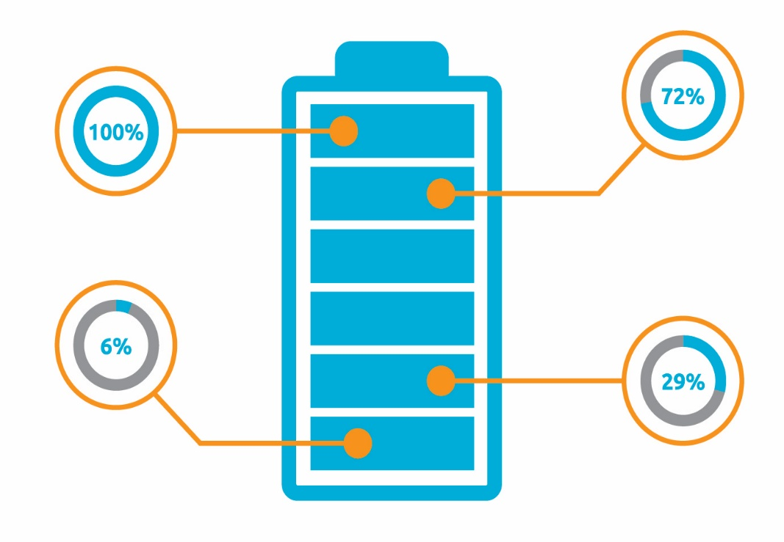
1
Challenges with Current Battery Data
2
Enter Battery Archive (BA)
3
Background and development of BA
4
Problems and solutions to scaling up BA
5
Summary

Slide 3
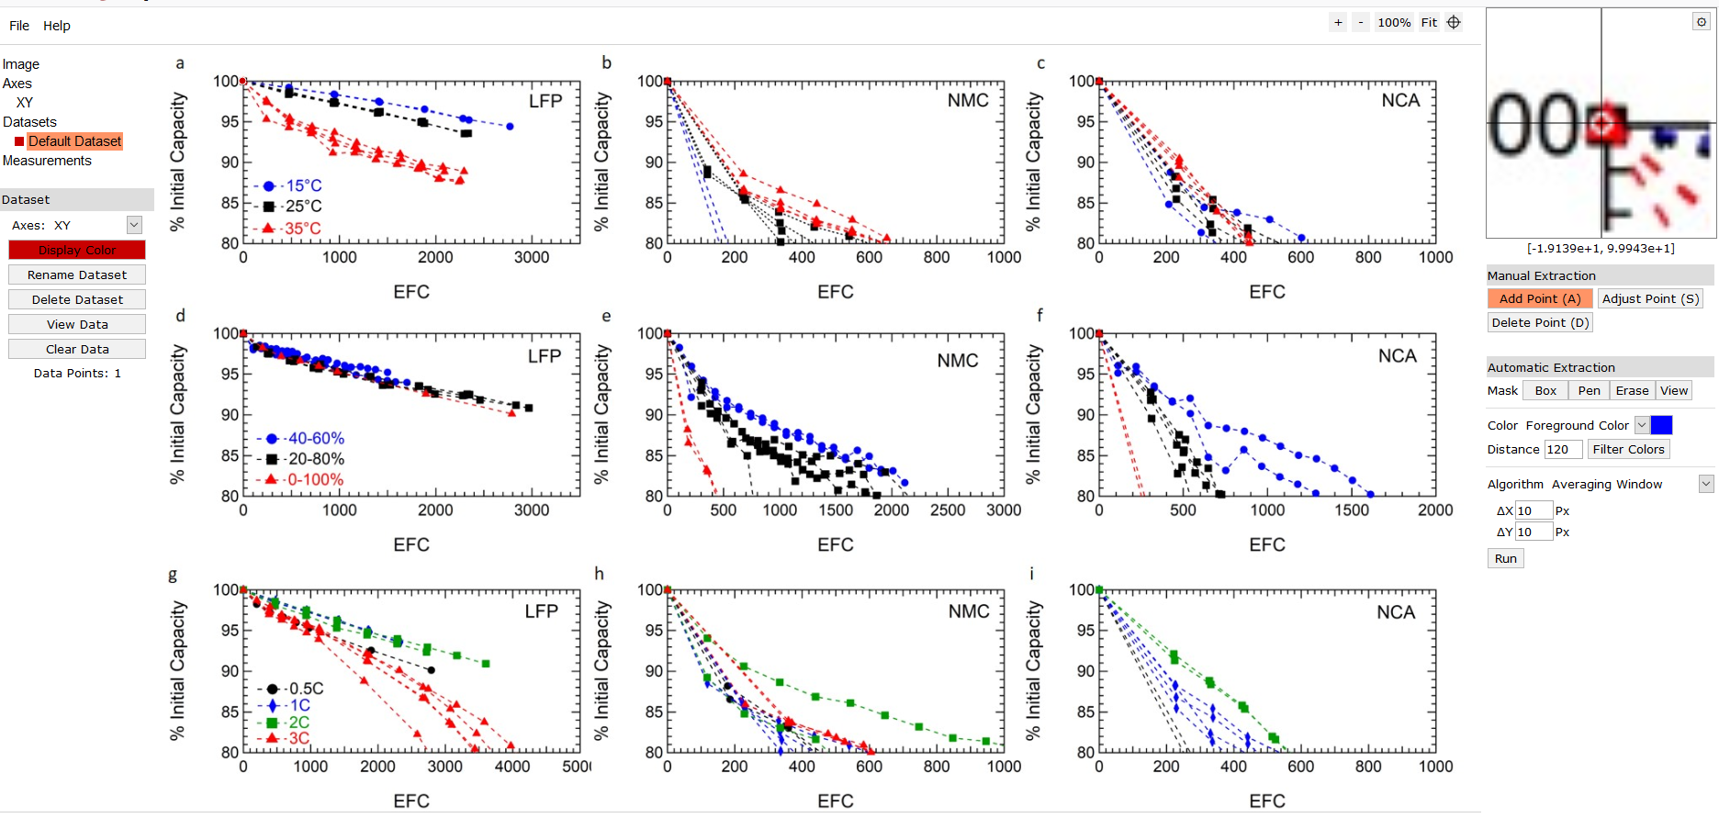
Challenges in comparing battery performance data
Little raw data are publicly available and extracting information from figures is time consuming

Slide 4
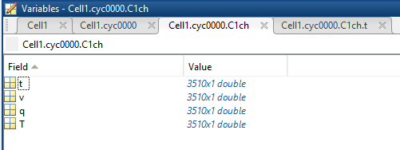
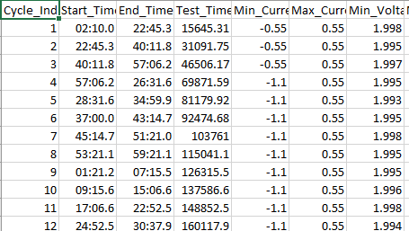
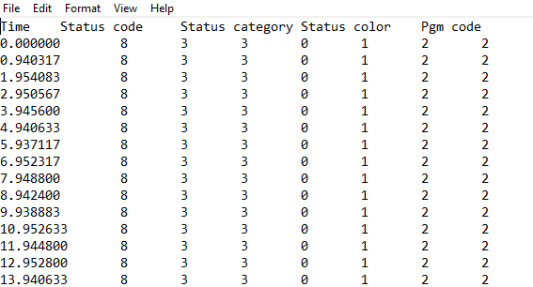
Challenges in comparing battery performance data
Even when the raw data are available the data are often in different formats
Matlab
Excel
Txt

Slide 5
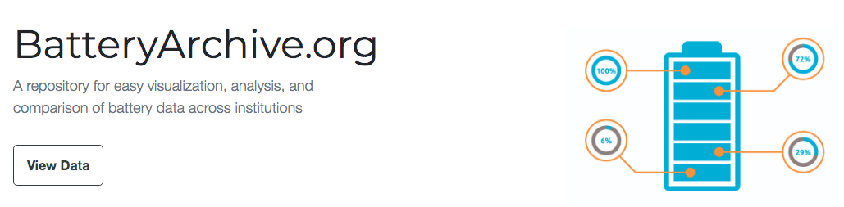
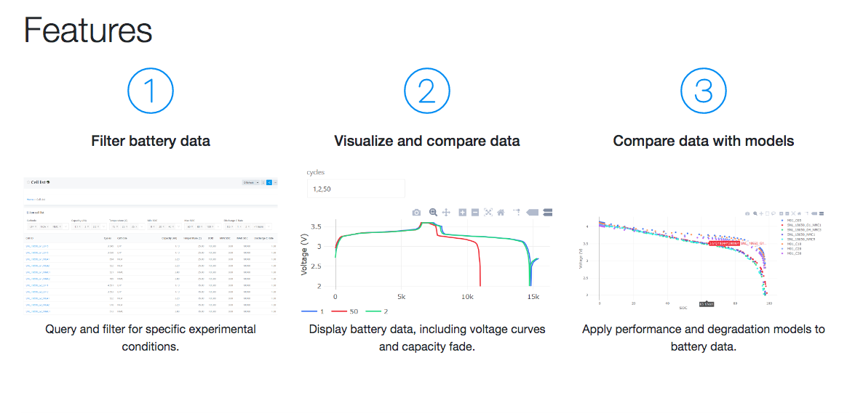
First multi-institution battery cycling database

Slide 6
Site development background
Target: simple enough for casual users to compare battery performance, but still useful for advanced modeling users
Key Features
Open access repository of battery data based on open-source software
Import data from excel, battery testers, online repositories (Google Sheets), and databases
Display the data in a responsive web interface and allow user download
Offer modeling and comparison functionality on the web app and through Jupyter Notebook
Adopt a standard minimum set of metadata, but plan for additional optional metadata
Complementary to existing archival approaches (e.g. have data in zip folder on your group’s website, data.mendeley, etc., but also combine here for comparison/manipulation)

Slide 7
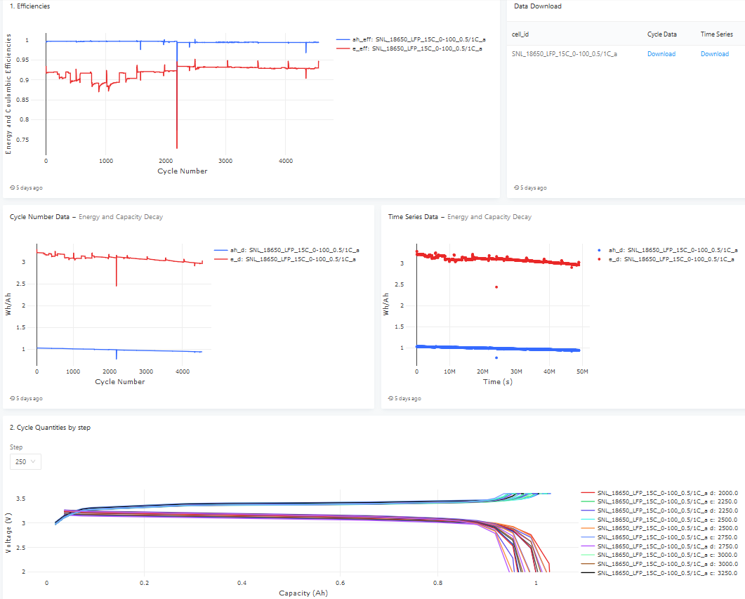
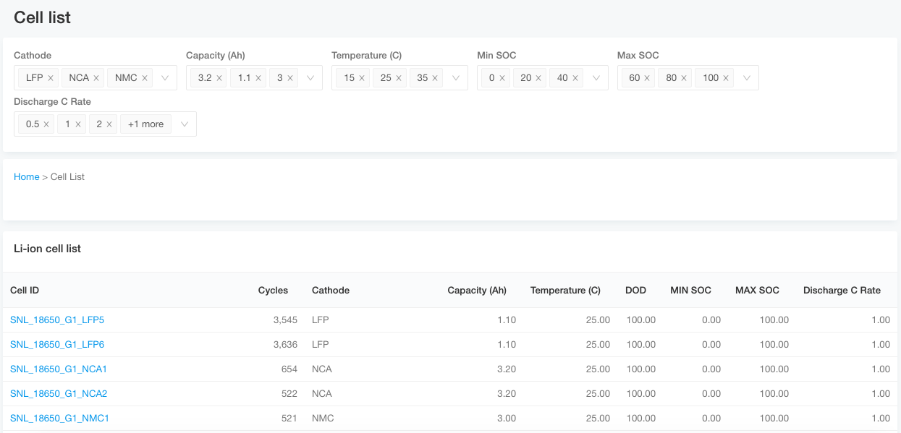
First multi-institution battery cycling database
Search by metadata related to cell + cycling conditions
Efficiencies, capacity and energy decay, and voltage curves automatically plotted for selected cells
All data translated to same format to enable easy comparison

Slide 8
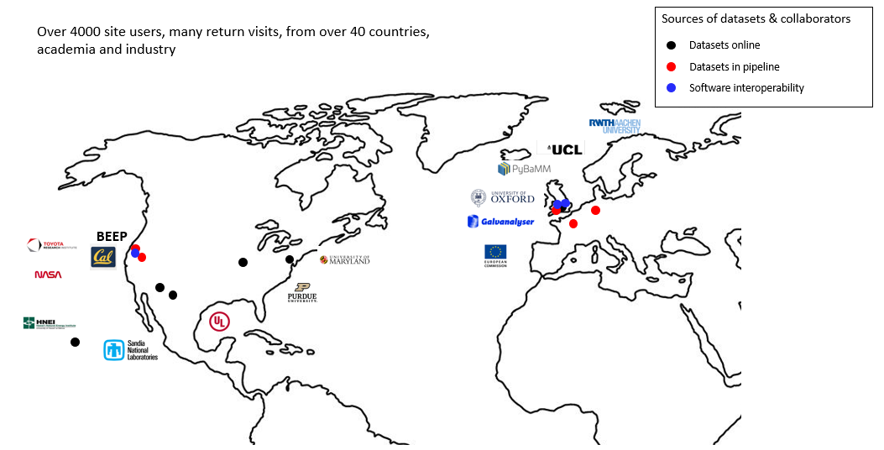
Current datasets

Slide 9
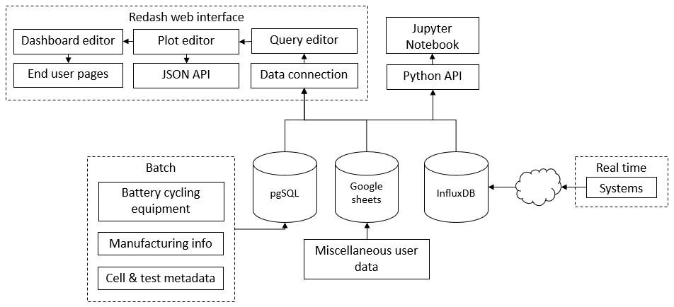
Release of open-source platform underpinning Battery Archive
Public site is based on the Battery Lifecycle Framework (BLC) - an open-source platform that provides tools to visualize, analyze, and share battery data through the technology development cycle
BLC has four components: (1) data importers, (2) one or more databases, (3) a front-end for querying the data and creating visualizations, (4) an application programming interface to process the data

Slide 10
Growing Pains
BA did not yet have a system for contributors to transfer large datasets to our databases, instead temporarily unpacking zip files sent via email or downloaded from various sites
BA wanted a way to edit battery metadata without giving explicit access to the battery database

Slide 11
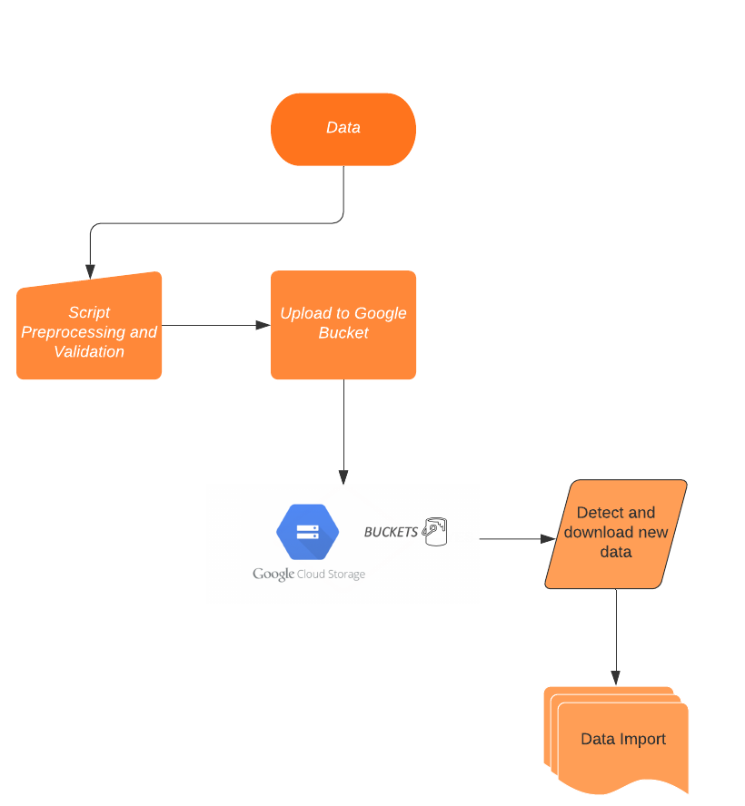
Getting Data to Battery Archive
Instead of manually adding datasets to the pgsql database ourselves I developed a way for anybody to upload large datasets to a Google Bucket Storage Space
The script I developed also validates and preps the datasets to be imported and added to the database
This method is available to anybody who can make a google cloud account and locally install google sdk, a set of tools and client libraries for using google cloud
After this, simply running the script will ensure that datasets are sent to us for processing

Slide 12
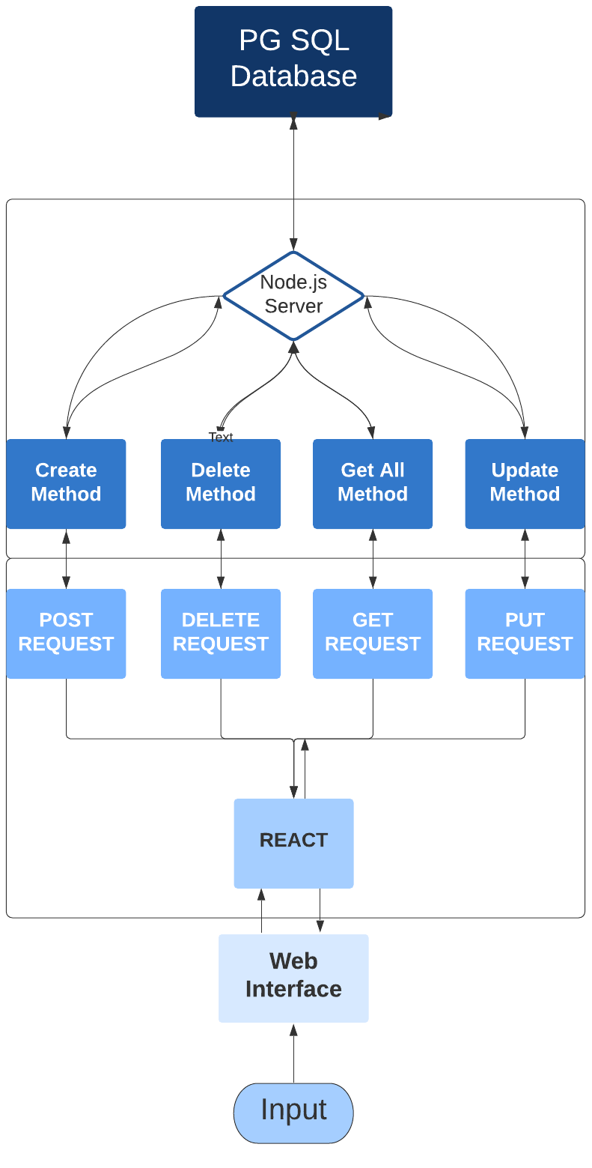
Metadata Review Before Release
Once the data has successfully made it to our database, I have developed a staging area from which to easily edit and delete metadata from the database without giving away explicit access
The editing area uses modern frameworks like node.js and react to establish a link between the database and the webapp
This allows us to make quicker and easier changes to the database whenever it becomes necessary (i.e. we are contacted by the data contributor to update metadata on a cell or the provided data is incorrect)
This combination of react, node.js, and SQL has enabled us to create editing tools that are independent of a dataset’s metadata schema, which will allow us to accept various metadata formats from our different contributors

Slide 13
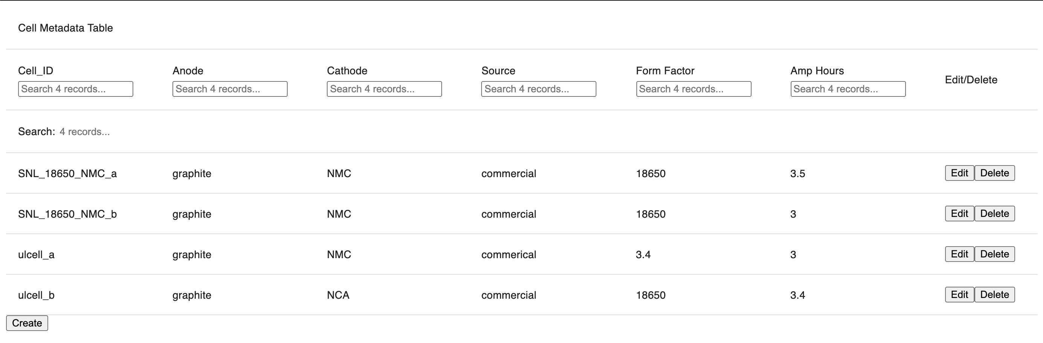
Metadata Editing Interface
The table synchronously displays all the data currently in the database metadata table along with buttons to edit, delete and create cells. It also supports search functionality in each column.
Image of the React interface

Slide 14
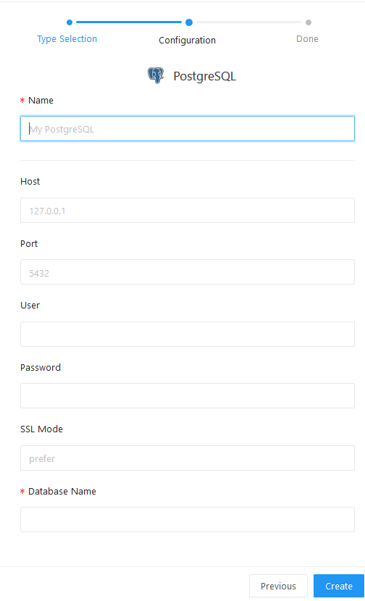
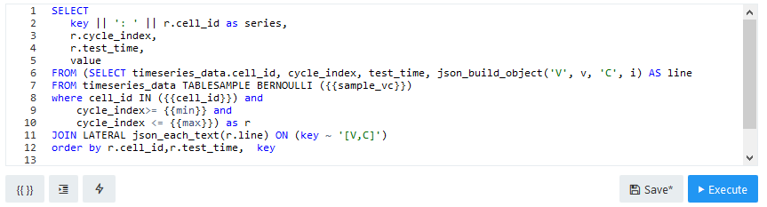
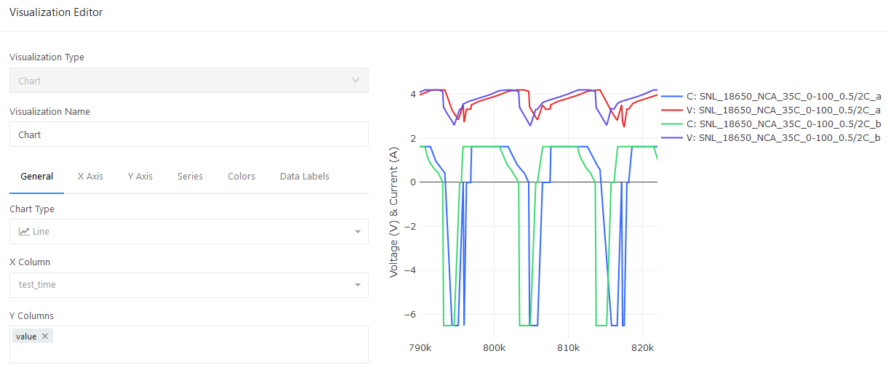
Managing data connections and visualizations with Redash
1) Create a New Data Source 2) Build Data Queries
3) Build Visualizations
4) Manipulate Visualizations

Slide 15
Summary
Battery Archive is the first multi-institutional battery database with a lot of in-built functionality that allows users to filter, model, and visualize datasets all within one platform.
To help improve upon Battery Archive’s existing infrastructure I contributed two main components:
A dataset transfer system that can take datasets from any computer with a google cloud account and google sdk toolkit installed and upload them to a public write-only google storage bucket to then be automatically imported (the data import stage calculates additional quantities) to the BA database
A metadata editing interface that will allow us to dynamically change metadata on the fly rather than having to reupload the entire dataset through the computationally intensive data import process. The metadata interface will also allow us to accept and modify different metadata schemas.

Slide 17
Thank you.

Slide 18
Acknowledgments
Funded by the U.S. Department of Energy, Office of Electricity, Energy Storage program. Dr. Imre Gyuk, Program Director.
Early framework testers at CUNY Energy Institute: Sanjoy Banerjee, Jinchao Huang, Andreas Savva, Gautam Yadav
Front end: Sam Roberts-Baca (SNL)
Database: Mark Spoonamore (SNL)
Early site feedback: Matthieu Dubarry (HNEI)
Founders: Valerio De Angelis and Yuliya Preger
Sandia National Laboratories is a multimission laboratory managed and operated by National Technology & Engineering Solutions of Sandia, LLC, a wholly owned subsidiary of Honeywell International Inc., for the U.S. Department of Energy’s National Nuclear Security Administration under contract DE-NA0003525.
Public site: www.BatteryArchive.org
Battery Lifecycle Framework Preprint: https://ecsarxiv.org/h7c24
Github: https://github.com/battery-lcf/battery-archive-sandbox
For questions about this presentation: asafdari@umich.edu ypreger@sandia.gov

